Slide 14




Slide 15



Slide 16


Slide 17
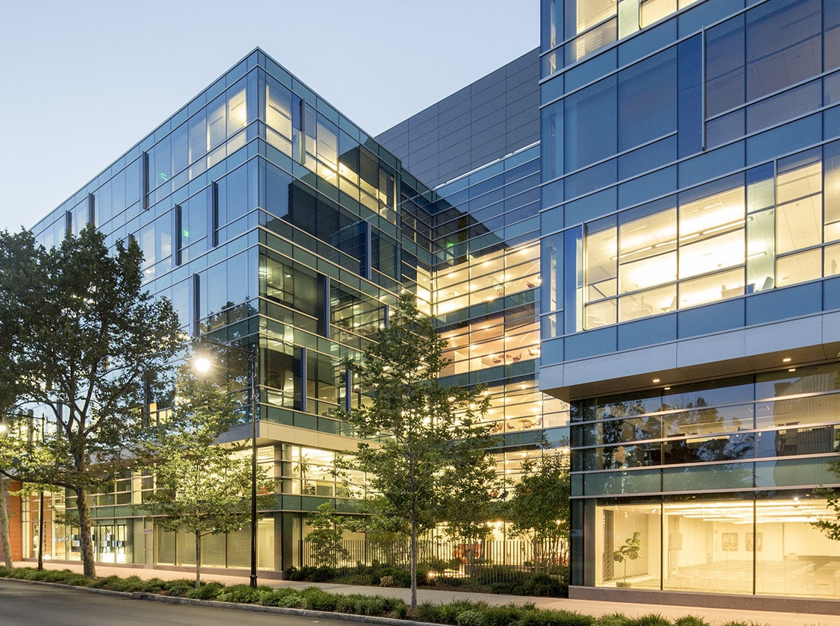

Slide 18


Slide 21


Slide 24


Slide 27


Slide 30


Slide 33


Slide 34


Slide 36

Instructional slide only, do not use
On Title Slides that use photography, copy the logo on this slide and paste it over the photo.
*use this logo on darker imagery
*hide this slide before publishing

Slide 37

Instructional slide only, do not use
On Title Slides that use photography, copy the logo on this slide and paste it over the photo.
*use this logo on lighter imagery
*hide this slide before publishing

Slide 38
Instructional slide only, do not use
If a photo covers the upper right side of a slide, copy the logo from this slide and paste it over the photo.
*use this logo on darker imagery
*hide this slide before publishing

Slide 39
Instructional slide only, do not use
If a photo covers the upper right side of a slide, copy the logo from this slide and paste it over the photo.
*use this logo on lighter imagery
*hide this slide before publishing

